Slide 1
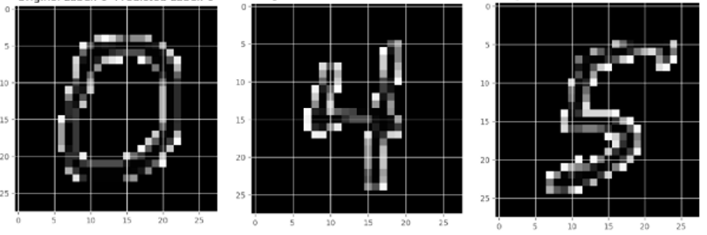

DIGIT RECOGNITION
PRIYANKA CHILLAKURU

Slide 2
PROBLEM
To identify digits correctly from dataset of tens of thousands of handwritten images.
To implement a self learning digit recognition algorithm which takes input from the user.

Slide 3
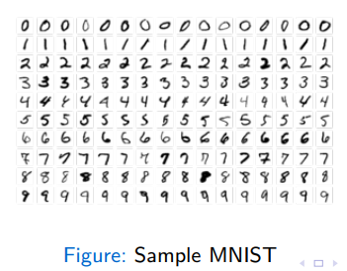
DATASET
A total of 70,000 images with 60,000 and 10,000 images for training and testing respectively. Each image are in 28*28 pixels format.
The training data set, (train.csv) has 784 columns i.e., grayscale and test.csv has 783 columns.

Slide 4
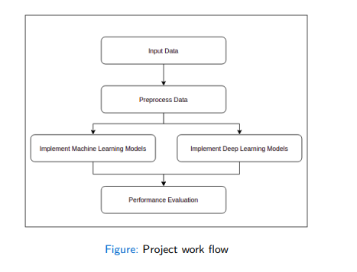
METHODOLOGY

Slide 5
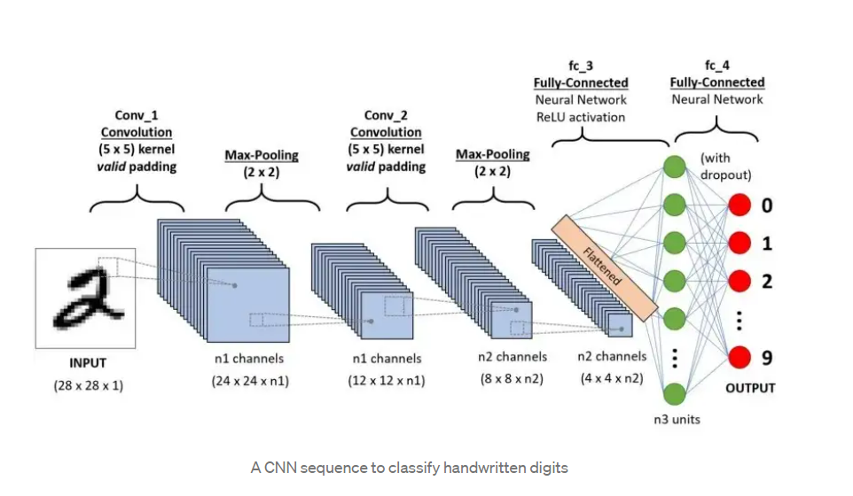
TECHNIQUES
A CNN is a kind of network architecture for deep learning algorithms and used for image recognition and tasks that involve the processing of pixel data.
Batch Normalization is used avoid improper initialization of weight matrices.
Principal component analysis used to achieve dimensionality reduction.

Slide 6
TECHNIQUES
Used Dropouts to avoid overfitting.
Optimizers to avoid loss (using weight updating rule to achieve good performance in the model)
We tried RMSPROP and ADAM.
Data augmentation - to avoid overfitting
Using CNN, Loss of 2D information due to image flattening is prevented

Slide 7
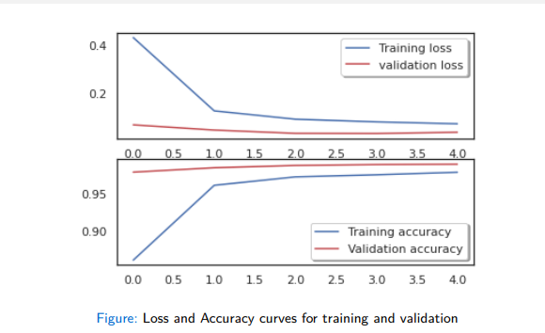
CONCLUSIONS
Using these techniques Train score: 95% accuracy for Validation score: 97%
when we keep increasing layers with different optimization technique, we can see that increase in validation accuracy.
When we apply the regularization model with dropout technique there is much added advantage in validation accuracy.

Slide 8
THANK YOU

